Slide 1

BIG-HERO 5
Amjad Alshehri
Aisha Alsoudi
Manar Alwsaidi
Nawal Almutairi
Suliman Busaleh

Slide 2
contents
01
02
03
04
Introduction
Dataset
Business Problem
The Code
Popularity
column
05

Slide 3
INTRO
01
What is Gathern?

Slide 4
Gathern
It’s a platform licensed and approved by the Ministry of Tourism to book holiday houses around Saudi Arabia. Users can book villas, chalets, apartments, farms, camps, and more holiday houses around Saudi Arabia.
The platform operates in more than 42,000 properties in 207 cities and provinces around Saudi Arabia
It was founded in 2016 with the aim to give users the ability to book from the platform private villas, chalets, rest houses,
camps, resorts, farms and other places suitable for gatherings.

Slide 5
02
DATASET

Slide 6
Gathern Dataset
- The dataset has around 66k records
It has 35 columns
It has data for only 2022 Aug
Dataset is only for Riyadh

Slide 7
POPULARITY COLUMN
03

Slide 8
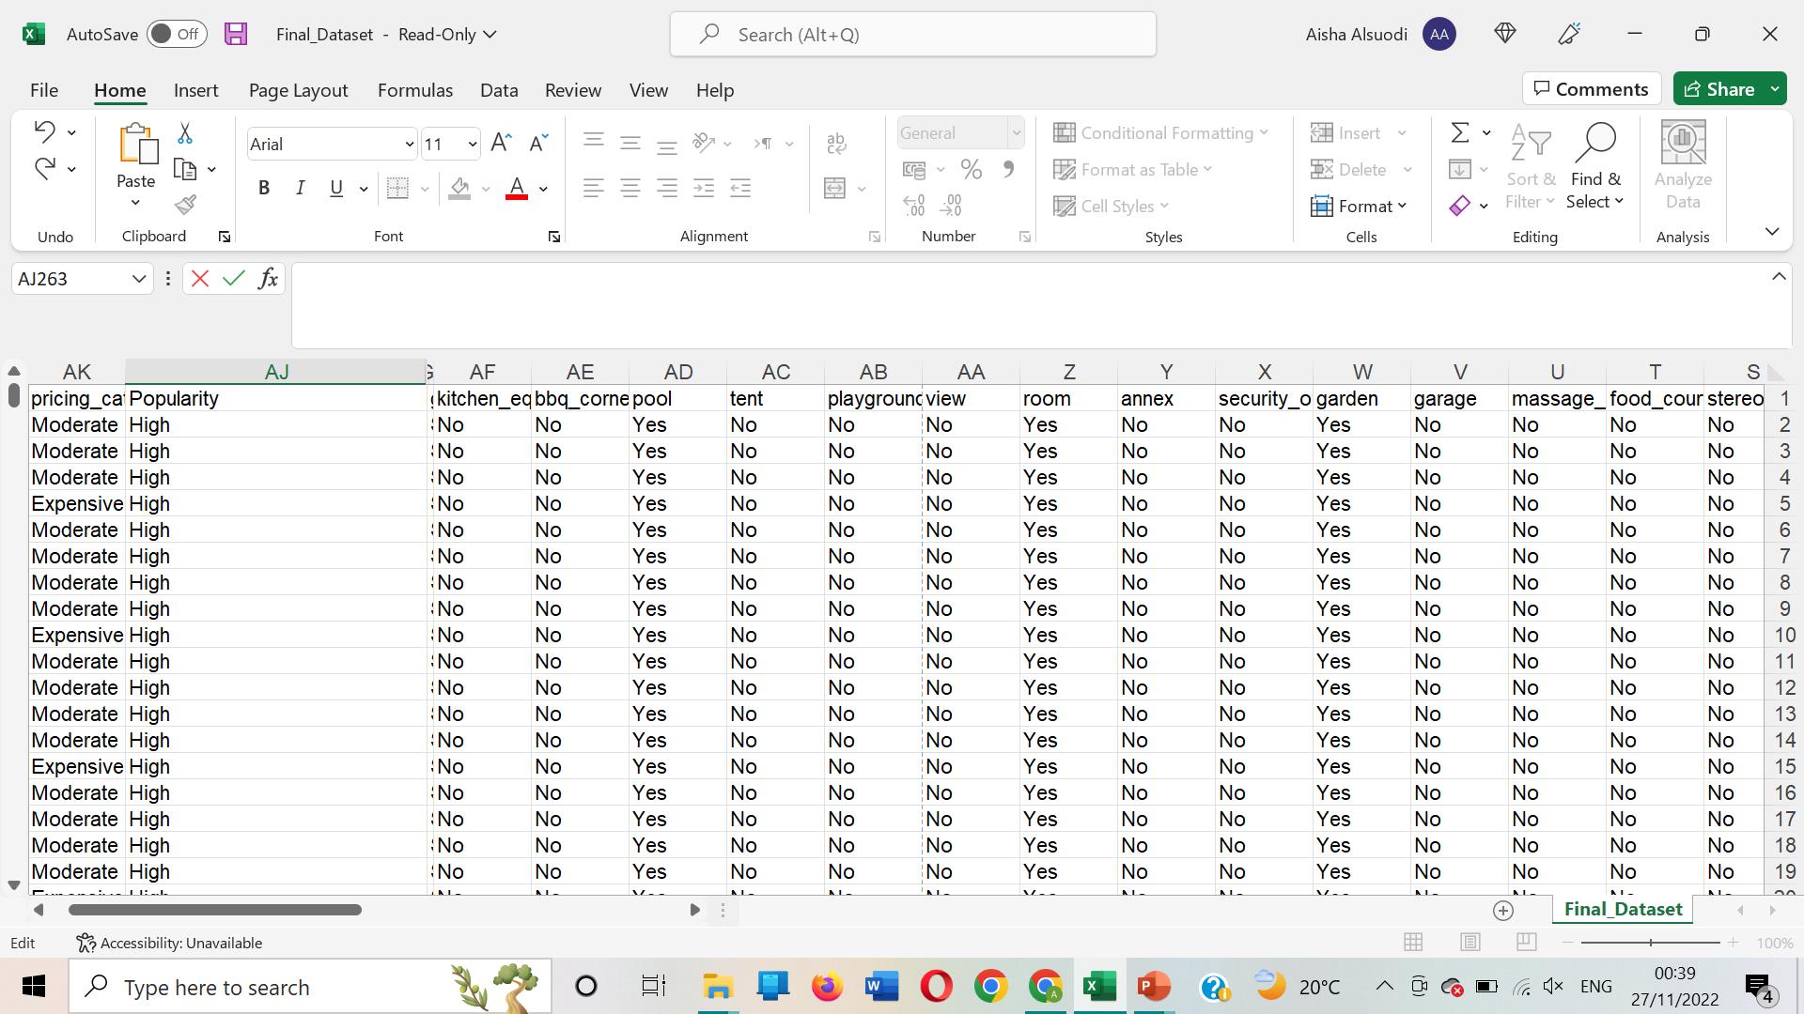
The Popularity column has :
High
Medium
Low

Slide 9
BUSINESS PROBLEM
04

Slide 10
Bussines Problem
Gathern needs to have more popular holiday houses.
More popular holiday houses will impact the platform repetition positively due to providing more popular and demanding holiday houses in the region.
After observing the holiday houses popularity, 25% of the holiday houses has low popularity (view count).

Slide 11
THE CODE
05

Slide 12
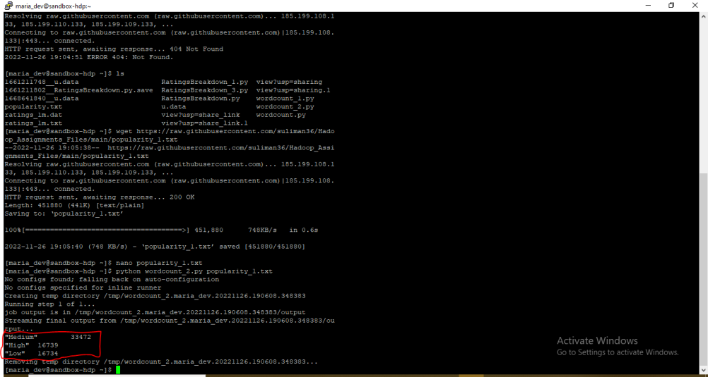

Slide 13
Thanks
any questions?

